Slide 1



Deep Image-Based Adaptive BRDF Measure
Wen Cao
Linköping University, Sweden

Slide 2
Contents
Material Representation and Measure
BRDF Estimation from CNN
Adaptive Reflectance Sampling
Results

Slide 3



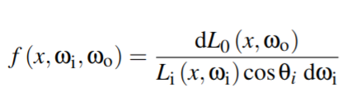
Material Representation ---BRDF
Analytic models
Tabulated measurement
BRDF:

Slide 4
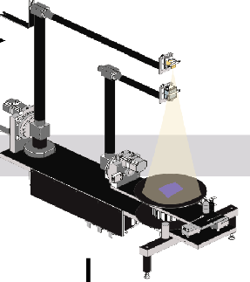
BRDF Measure
Tabulated Measurement
About 3 days

Slide 5
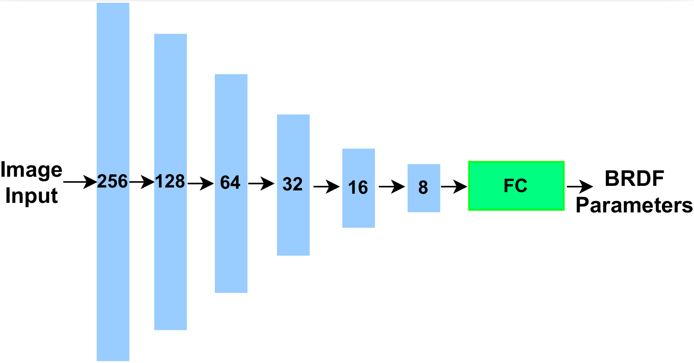
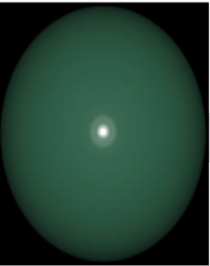
BRDF Estimation from CNN
Analytic models

Slide 6
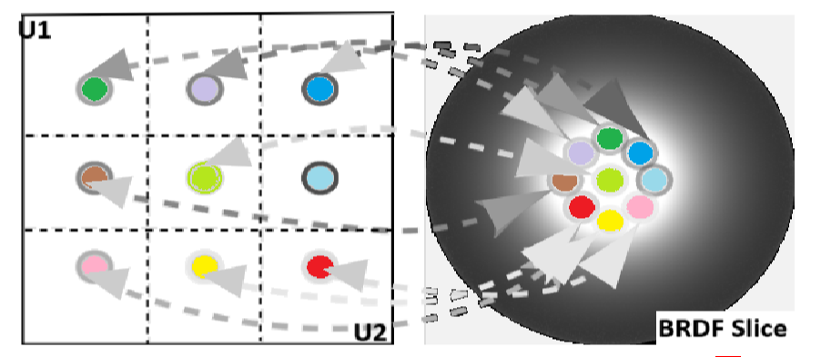
Adaptive Reflectance Sampling
Analytic models
Adaptive Sample
BRDF Measure
Notes:
There is a high dimensionality gap.

Slide 7
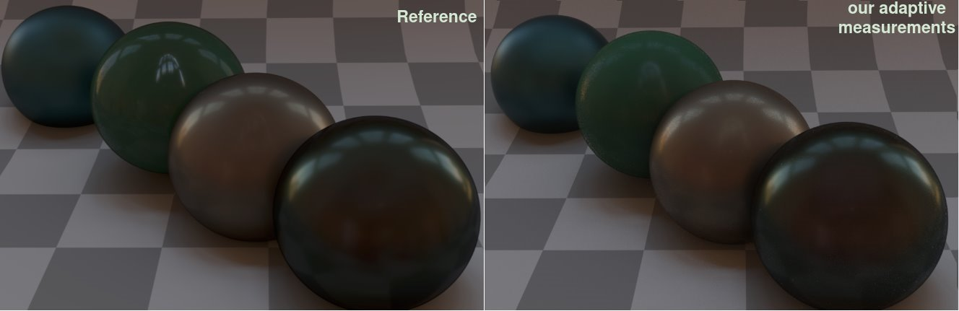
Results

Slide 8
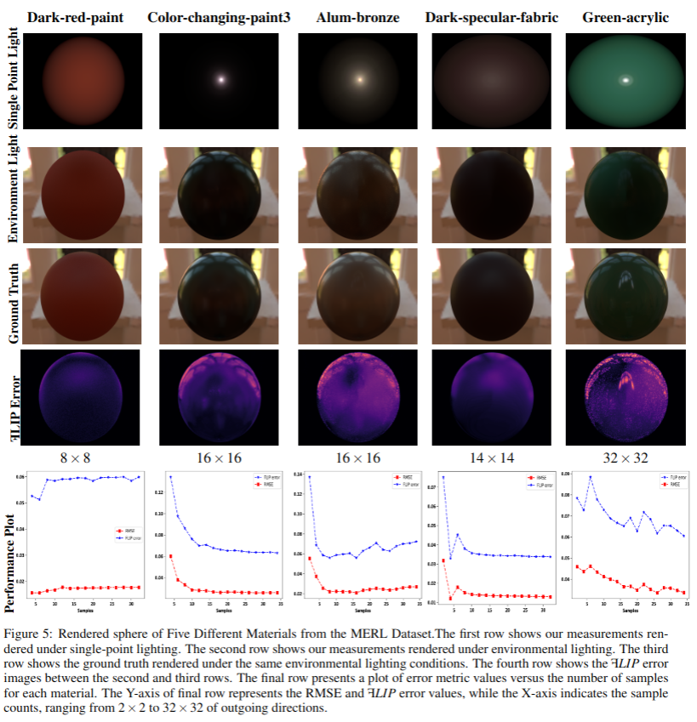

Slide 9
Conclusion
We propose an image-based adaptive BRDF sampling method that significantly reduces BRDF measurement time while maintaining high accuracy and fidelity.
We use a lightweight neural network and show that it can accurately estimate BRDF parameters and that this, in turn, can be used to importance sam- pling new directions for taking measurements.

Slide 10

Thank you for Listening
This research is a part of PRIME which is funded by the European Union’s Horizon 2020 research and innovation programme under the Marie Skłodowska Curie grant agreement No 956585.

